Slide 1
Robust and Scalable Deep Learning for X-ray Synchrotron Image Analysis
Presenter: Ziqiao Guan, Nicole Meister, Ronald Lashley
Nicole Meister^{1,2}, Jinzhen Wang³, Ronald Lashley⁴, Ziqiao Guan⁵, Bo Sun⁶, Hong Qin⁵, Kevin Yager, Dantong Yu³
Work done at Brookhaven National Laboratory
¹Simons Summer Research Program ²Centennial High School ³New Jersey Institute of Technology
⁴Lincoln University ⁵Stony Brook University ⁶Rowan University

Slide 2
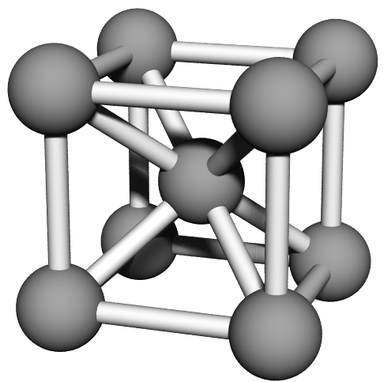
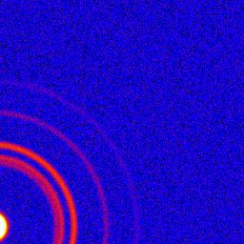
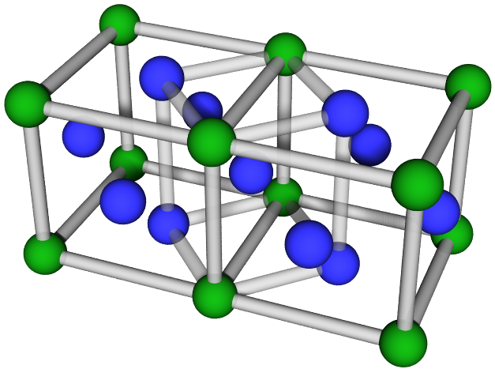
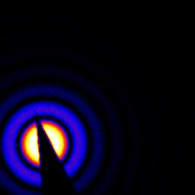
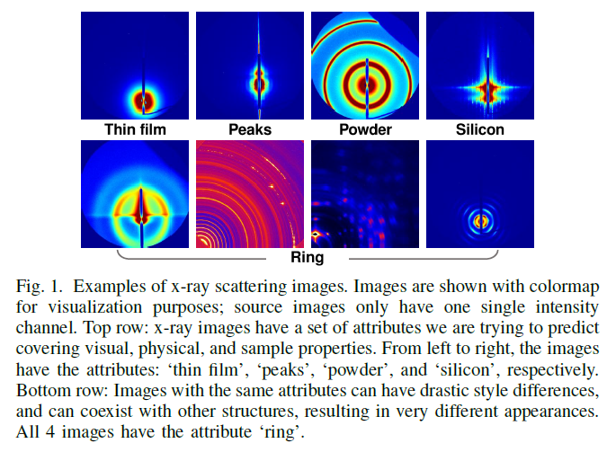
Background
BCC
NSLS-II produces x-ray scattering images for material analysis and discovery
Big data at NSLS-II with large data volume and variability
1-4TB images/day
100+ attribute tags of interest
Diversity in image config. and quality
FCC
Notes:
How x-ray scattering images are formed and significance of image analysis.
X-ray images are…
A representation of spatial config. of microscopic particles. Bcc, fcc
NSLS provides big data opportunity of x-ray images/scientific images: 1. 2. 3.
Figure on bottom right shows between labels/ within a label
Presents a challenge for

Slide 3
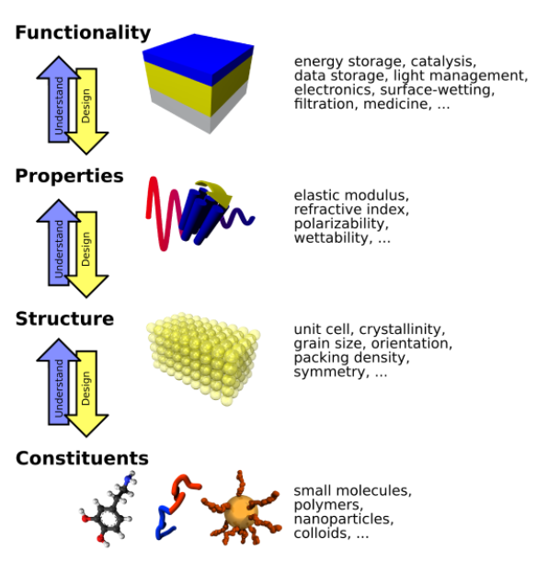
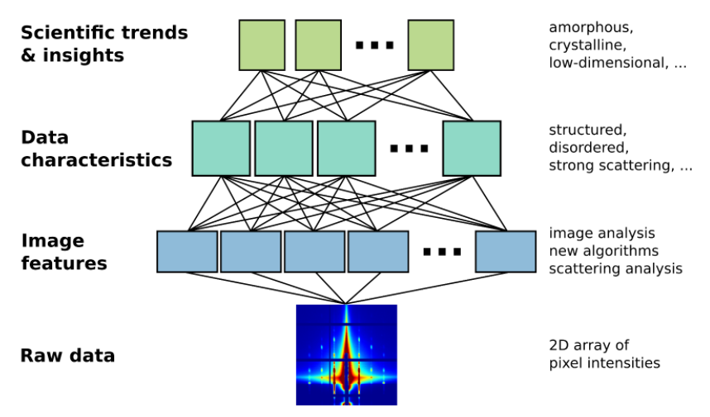
Research Goals
Build automatic machine learning pipelines for data analysis tasks
Hierarchical physics aware learning
Streaming and real-time learning capabilities
Experiment and decision making assistance
Notes:
Our aim is to …
We identify 3 overarching goals
HPAL. Physics aware. Incoporate. Machine benefit from physics understanding and thinking as an expert thinks. Hierarchical.
Streaming. Don’t wait for disk. On the fly. w/o badly written scripts.
Decision. Help w experiment. Instrument steering, point in right directions of material synthesis.

Slide 4
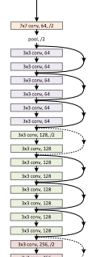
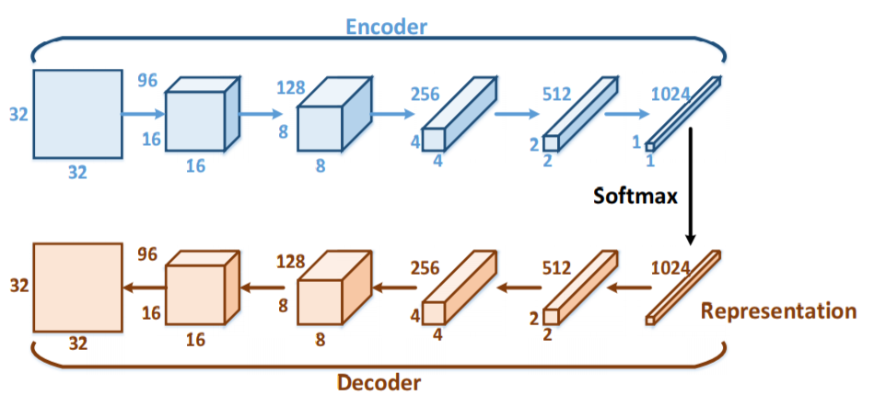
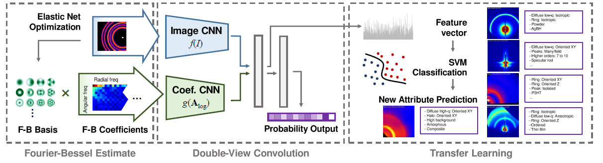
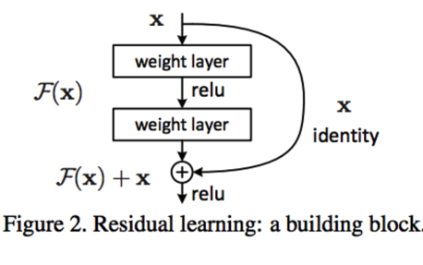
Deep Learning Approaches
We adopted popular deep ConvNets, RNNs in computer vision communities for x-ray scattering image analysis tasks
Conv Autoencoders, Residual Nets, 2-stream CNNs, etc
Outstanding problem: conduct learning in a physics, experiment and R&D aware context
[Wang et al. 2017]
[He et al. 2016]
[Guan et al., in submission]
Notes:
Main methods: deep learning. Not only popular, but actually works and fits big data.
One problem remaining: as a standard computer vision problem w well defined I/O, carefully preprocessed data and labels, w/o consider of exp uncertainties and data src; feels a bit taken out and not a continuous flow.
We hope to cope with real-production scenariaos and … in a … context

Slide 5
Outline
Four deep learning subproblems:
Data augmentation for robust learning
ConvNet learning with high-resolution images
TensorFlow for model integration and fast GPU computation
Streaming to TensorFlow
Streaming
Database/
Experiment Feed
TensorFlow Learning Model
Learning Dataset
Data Augmentation
High resolution
GPU Accelerated Preprocessing
Notes:
To bridge the aforementioned gaps, …
Data is not perfect and we train for better robustness
With finer details we hope for better performance
Exploit GPU and parallelization as much as we can
Put everything in one streaming framework and eliminate the needs for saving/reloading/parsing intermediate

Slide 6
PART I. Improving Robustness of the NSLS-II X-ray Scattering Image Neural Network with Data Augmentation

Slide 7
Background
The NSLS-II produces x-ray scattering images to analyze the physical structure of materials and proteins at a molecular and nano scale.
1-4 TB of X-ray scattering image data can be generated each day
NSLS-II has 60 beam lines
Double View Fourier Bessel Convolution Neural Network (DVFB-CNN)
Notes:
Should we use Double View or Joint
Use Joint Network stacks: one netowrk isn’t sufficient, put in multiple stack. One stack is physics aware: ensemble

Slide 8

Data Augmentation
Train the neural network with deliberately distorted images to improve its ability to recognize distorted and corrupted real data.
Apply Noise:
Gaussian Noise
Salt and Pepper Noise
Poisson Noise
Example Noise Free Image: Halo
Notes:
Gaussian: if beamline doesn’t line up exactly (the values that thenoise can take on are Gaussian-distributed.) Sigma=2, 4, 6
Salt and Ppepper noise:This noise can be caused by sharp and sudden disturbances in the image signal. It presents itself as sparsely occurring white and black pixels. Completely corrupts the image (10%, 20%, 30%) varying lambda, not clean leanses
When capturing an image, the image is one sample of the random event. We apply poisson distribution to model a chance observation of the images (causing variation in the value of the signal)
capturing image: chance observation

Slide 9
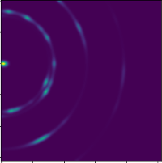
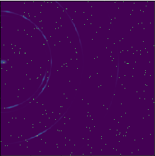
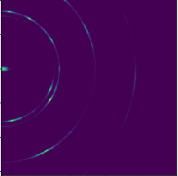
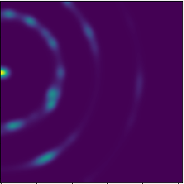
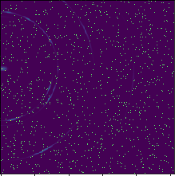
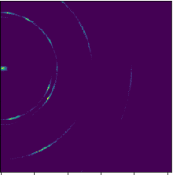
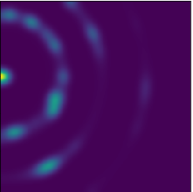
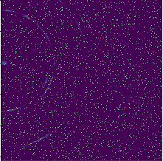

 | Gaussian Noise σ=2, 4, 6 | Salt and Pepper Noise λ = 0.005, 0.025, 0.05 | Poisson Counting Statistic λ = 100, 1000, 10000
1
2
3
Cause | Beam line doesn’t align correctly, blurry lenses | Dropouts, sharp disturbances in signal | the fluctuations in the # of photons is significant.
Method | Image array takes on values that are Gaussian distributed | Apply Poisson distribution to randomly corrupt values in array | Apply Poisson distribution to model chance observation
Notes:
Three types of noise: happens a lto in real experiments (justify)
Beamline scientists must deal with this noise
Why not use data preprocessing to clean up the image? Image headling takes a longer time, we want the networkto be robust so we don’t have to correct it. This is big data technology
In my work, I am dealing with variablitity. The data varies. Ron is volume. velocity

Slide 10
Procedure
Train (Baseline)
Generate 50k noise-free x-ray scattering images
Train the Neural Network
Generate 5k x-ray scattering images
Apply Noise: Gaussian, Salt and Pepper, Poisson
Data Augment-ation
Generate 50k noise-free images
Apply Noise
Evaluate image performance in neural network
Generate 50k images with random amounts of noise
Retrain Neural Network with 100k images
Evaluate
Evaluate and compare the performance of the original 5k images in the newly trained neural network
Train (Baseline)
Generate 50k noise-free x-ray scattering images
Train the Neural Network
Generate 5k x-ray scattering images
Apply Noise: Gaussian, Salt and Pepper, Poisson Counting Statistic (Python)
Data Augment-ation
Generate 50k noise-free images
Apply Noise
Evaluate image performance in neural network
Generate 50k images with random amounts of noise
Retrain Neural Network with 100k images
Evaluate
Evaluate and compare the performance of the original 5k images in the newly trained neural network
Notes:
50k noisy images: random amount of Gaussian, salt and pepper, or Poisson noise applied to prevent over fitting so that the neural network did not get too accustomed to a fixed amount of noise.

Slide 11
Results
As the level of noise increases, the accuracy of Joint CNN decreases

Slide 12
Results
 | Image CNN | FBB CNN | Joint CNN
No Noise (Pre) | .51075 | .56022 | .63442
No Noise (Post) | .633947 | .619969 | .624864
By considering information from both the image and the FBB coefficients, the Joint CNN improves the neural network’s ability to classify X-Ray scattering images
Notes:
Demonstrate joint cnn improves the cnn combining info from the image and from the fourier bessel transform
Demonstrate noise does affect the precision of the CNN
Define no noise pre, no noise post
Describe the data in the chart

Slide 13
Results
mAP (Mean Average Precision)
Notes:
The post training MAP
INCLUDE ZERO PERCENT
Use exact numbers to describe the difference between pre and post
Effect of data noise: mitigated (notice the gaps)
If I keep augmenting data, I may be able to close the gap even more

Slide 14
Results
mAP (Mean Average Precision)

Slide 15
Conclusions & Future Work
After training with the three forms of noise, the joint CNN model improved accuracy by about 10%
After introducing high levels of noise, the model improved less, suggesting that these images are too corrupt for the model to classify
While the model could now better classify images with noise, the precision only increased by 2% when classifying noise free images.
Future Work: Evaluating the model with real data (although limited)

Slide 16
PART II. ConvNet Learning with High-resolution Images
Notes:
Next we look into another direction
Due to conventions, a lot of work takes fixed size input e.g. 256, which is small compared to detector 1k, up to 2k 3k. Downsampling causes loss of finer structures.

Slide 17
Why synthetic images/ data?
Real x-ray scattering images may not be easily accessible or may not be ready as of yet.
Synthetic x-ray scattering allows us to develop as many images and data as wanted that is close to the real dataset.
We have proposed to use a larger image size instead of downsizing to 256 x 256 as we have been doing.

Slide 18
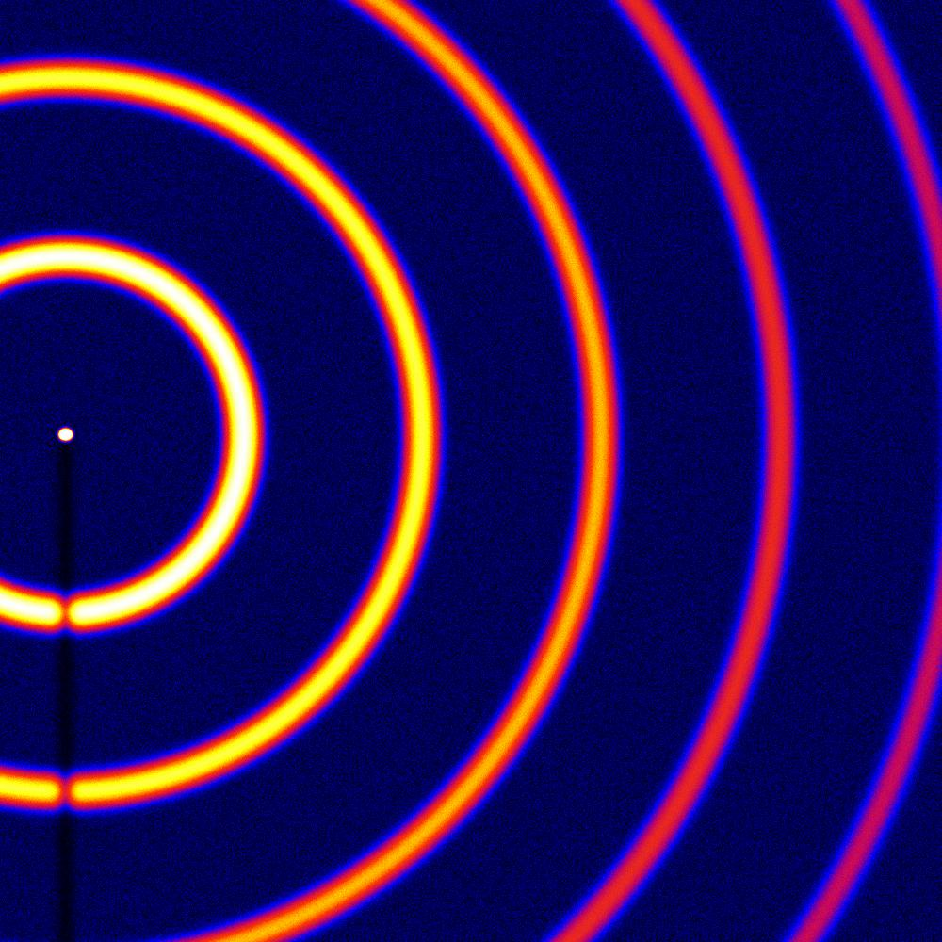
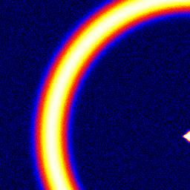
Plan
Originally we have been working with the image size 256 x 256-pixels.
Moving to the data size of 1K x 1K-pixels increases the image resolution making it easier to recognize various features and tag them.
256 X 256 Image
1K x 1K Image

Slide 19
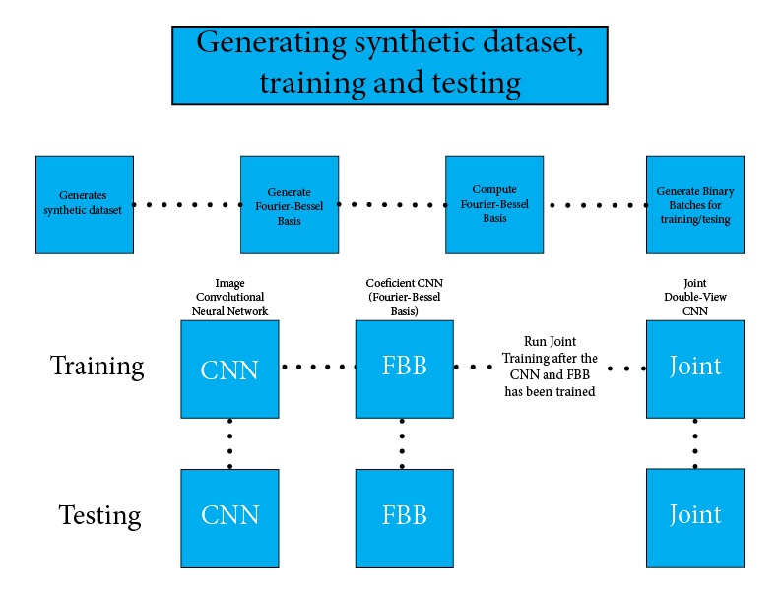
Notes:
Compute Fourier-Bessel transform (FBT): This is slow and it could take a day ~ a few days with the original dataset of 256x256 therefore we assume it will take longer for the larger dataset.
Generate binary batches for training/testing: (binary batches: we condense all the generated data in batches of raw data records for fast I/O in TensorFlow. Batch files are divided into fixed length byte intervals that save a (tags, image pixels, FBT) tuple each).
Begin Training and Testing

Slide 20
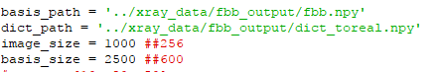
Generating 1K x 1K-pixel images
To increase the image size, we changed a few parameters to set the image size to 1K x 1K which is done by setting the x and y to 1000.
Also, we changed the basis size from 600 to 2500. The basis size allows the system to take consideration that the beamline wasn’t lined up with the center. This sets a range to ensure the image is captured.

Slide 21
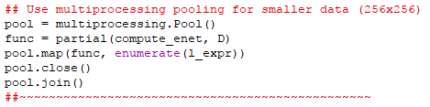
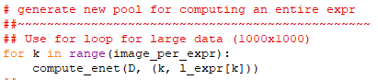
Big Data Issues
Length of time to generate 50K images with a size of 1K x 1K vs generating 50K images with a size of 256 x 256
Limited time to generate 50K images on cluster
Cluster only allows long jobs to be ran for 24 hours which isn’t enough time to generate 50,000 1k x 1k images.
To solve this we had to generate less experiments per job and submit multiple jobs to total up to 50,000
Computing Fourier-Bessel Basis
Because of the large size of the data multiprocessing pooling therefore it had to be replaced with a for loop to enumerate through the images

Slide 22
Notes:
200 images/ experiments
200I1E 256x256: 1min25sec (85secs) 200I5E 256x256: 3 min 54secs (224secs)
200I1E 1k x 1k: 7mins 15secs (435secs) 200I5E 1K x 1K: 34mins (2040secs)
5 times longer to generate 9 times longer to generate

Slide 23
Next..
Compute Fourier-Bessel transform (FBT): This is slow and it could take a day ~ a few days with the original dataset of 256x256 therefore we assume it will take longer for the larger dataset.
Generate binary batches for training/testing: (binary batches: we condense all the generated data in batches of raw data records for fast I/O in TensorFlow. Batch files are divided into fixed length byte intervals that save a (tags, image pixels, FBT) tuple each).
Begin Training and Testing

Slide 24
Part III. TensorFlow for Model Integration and Fast GPU Computation

Slide 25
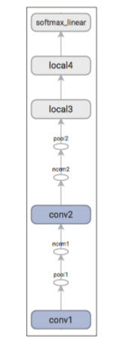
Motivation
With TensorFlow ConvNets, our data preprocessing steps (e.g. sparse solver) are still Scikit-learn based
Aim: GPU speedup and end-to-end
Use TF for data preprocessing too!
TF ConvNet
Notes:
As Tensor-Flow has always been know as an open source library for Machine Learning, it has made the modeling and training of machine learning algorithms much easier.

Slide 26
TensorFlow Fourier-Bessel Transform
CPU
TensorFlow (GPU)
Precompute Basis
Image Shifting
Basis Cropping
TensorFlow Matrix Manipulation
Matrix Reshaping/Transform
sklearn Sparse Solver
TensorFlow Optimizer
TensorFlow Learning Model

Slide 27
Experiment Results
We compare the time to compute the fbb coefficients for 1,000 images, CPU only vs 1 GPU, on Stony Brook SeaWulf cluster
module | Time (s)
fbb_enet_cpu | 6933.7525
fbb_enet_gpu1 | 4026.4528
*More speedup should be possible when solving the sparse problem is also done in TF.

Slide 28
Future Plan: TensorFlow Cluster
Notes:
In TensorFlow we can create a TensorFlow Cluster which is composed of one or more TensorFlow servers, aka tasks. Tasks are grouped into jobs where multiple tasks have common role such as PS for parameter server.

Slide 29
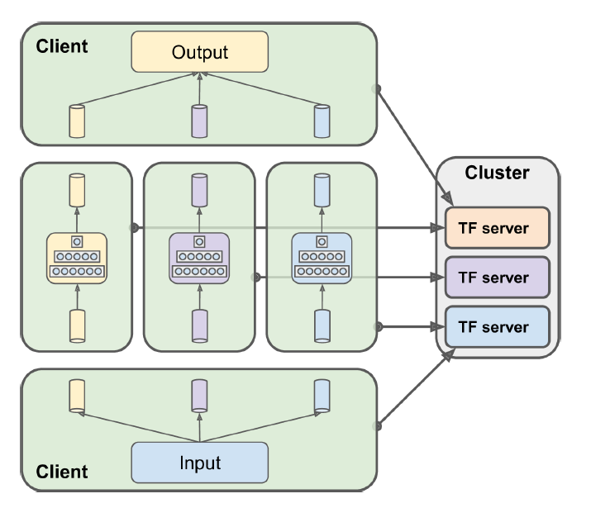
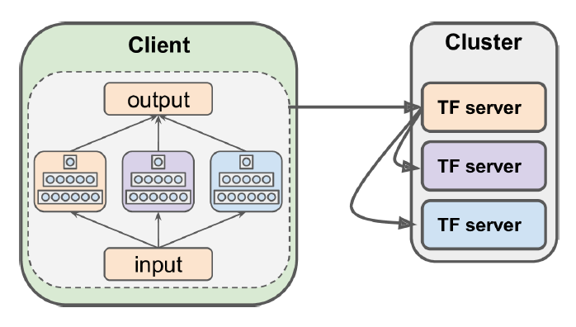
Future Plan: In Graph vs Between Graph
Notes:
.

Slide 30
Part IV. Streaming to TensorFlow

Slide 31
Motivation
Streamline data analysis at x-ray beamlines
Kevin Yager, Julien Lhermitte, SciStreams library. http://scistreams.readthedocs.io/en/latest/
Incorporate TensorFlow machine learning module to the streaming framework
Notes:
Bridge the final gap between data and learning model. Solve the problem of where the data come from and how it is organized: stream

Slide 32
Streaming Data Analysis
X-ray data analysis tasks:
Retrieve/save data from multiple sources
Cache/store/retrieve intermediate results
Chain computations and pass metadata
Distributed computing
Modularization and abstraction
For better legibility and flexibility of code
For scientists to build analysis pipelines rapidly
Notes:
… shown in the following example

Slide 33
Data Streaming with SciStreams
def mtimes2(a):
return 2*a
# less lines but this can get messy
print(mtimes2(1))
Procedural Programming
# This originally comes from http://www.github.com/mrocklin/streams
from SciStreams.interfaces.streams import Stream
# functions
def mtimes2(a):
return 2*a
# set up the computations
sin = Stream()
s2 = sin.map(mtimes2)
sout = s2.map(print)
# the data is sent through 'emit' (loop over this for incoming data)
sin.emit(1)
Data and calibration ops
Normalization
Circular average
Image stitching
…
Computation Graph with Lazy Evaluation
Notes:
Long nested function calls. Data and logic binded, hard to maintain

Slide 34


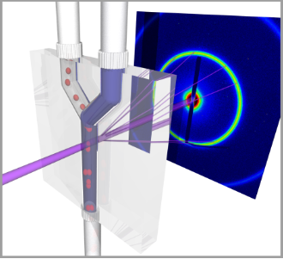
Deep Learning in Data Streaming
Label
Image data
…
Data Source
SciStreams Workflow
TensorFlow Model

Slide 35
Summary
We study four problems in in-situ scientific image deep learning
Data augmentation
High resolution image learning
TensorFlow model integration
Streaming in TensorFlow
Scientific image deep learning as online service

Slide 36
Thank you for your attention
Questions?

